Slide 1



Introduction
George Mount, Data Analyst & Educator at Stringfest Analytics
George works as an independent analyst and data analytics educator with the goal to help clients manage their data so they think more creatively. He serves as a technical expert and lead curriculum developer for Thinkful’s data analytics program and is the instructor of the DataCamp course “Survey and Measure Development in R.” George blogs about data, innovation, and career development at georgejmount.com. He holds a master’s degree in information systems with a certificate of achievement in quantitative methods from Case Western Reserve University.

Slide 2


R-Powered Excel for Business Analytics
Month/Year

Slide 3
Objectives for today
Load, view and write Excel files from R

Slide 4
Objectives for today
Load, view and write Excel files from R
Perform common data wrangling tasks such as sorting, filtering, and aggregation, using the dplyr library

Slide 5
Objectives for today
Load, view and write Excel files from R
Perform common data wrangling tasks such as sorting, filtering, and aggregation, using the dplyr library
Navigate the RStudio integrated development environment

Slide 6
Objectives for today
Load, view and write Excel files from R
Perform common data wrangling tasks such as sorting, filtering, and aggregation, using the dplyr library
Navigate the RStudio integrated development environment
Identify, install and implement useful packages for your needs

Slide 7
Augment your Excel skills
R’s powerful universe of open-source packages and tools

Slide 8
Augment your Excel skills
R’s powerful universe of open-source packages and tools
The R equivalent of common Excel tasks such as PivotTables, sorting and filtering

Slide 9
Augment your Excel skills
R’s powerful universe of open-source packages and tools
The R equivalent of common Excel tasks such as PivotTables, sorting and filtering
Where R can augment and automate common data preparation and manipulation tasks often done in Excel

Slide 10
Augment your Excel skills
R’s powerful universe of open-source packages and tools
The R equivalent of common Excel tasks such as PivotTables, sorting and filtering
Where R can augment and automate common data preparation and manipulation tasks often done in Excel
The role of vectors, objects, and functions in R

Slide 11
R and Excel for Business Analytics

Slide 12
What is R and when would you use it?
R is...
A programming language

Slide 13
What is R and when would you use it?
R is...
A programming language
A statistical package

Slide 14
What is R and when would you use it?
R is...
A programming language
A statistical package
Open-source

Slide 15
What is R and when would you use it?
R is...
R is not...
A programming language
A statistical package
Open-source
A spreadsheet

Slide 16
What is R and when would you use it?
R is...
R is not...
A programming language
A statistical package
Open-source
A spreadsheet
A database

Slide 17
What is R and when would you use it?
R is...
R is not...
A programming language
A statistical package
Open-source
A spreadsheet
A database
Commercially supported

Slide 18
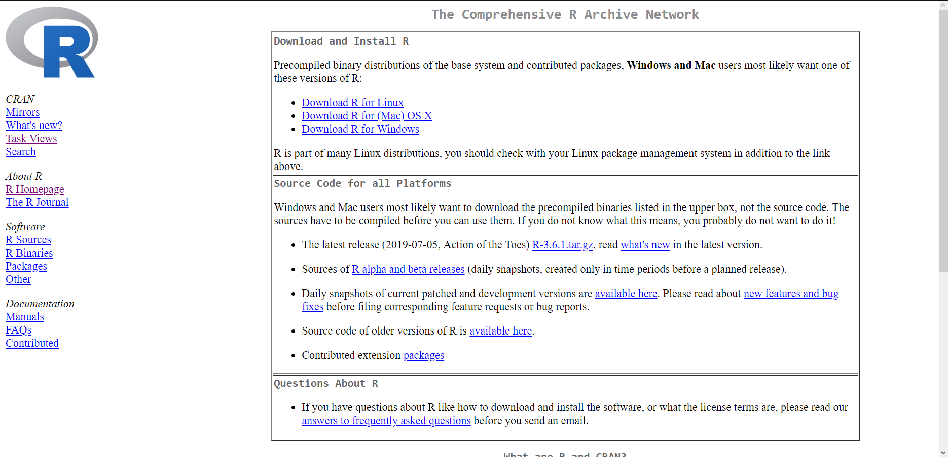
CRAN: Maintains the “source code..

Slide 19

Which anyone can build on...

Slide 20
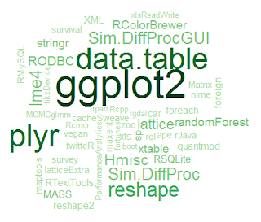
… or contribute packages to.
https://www.r-bloggers.com/the-50-most-used-r-packages/

Slide 21
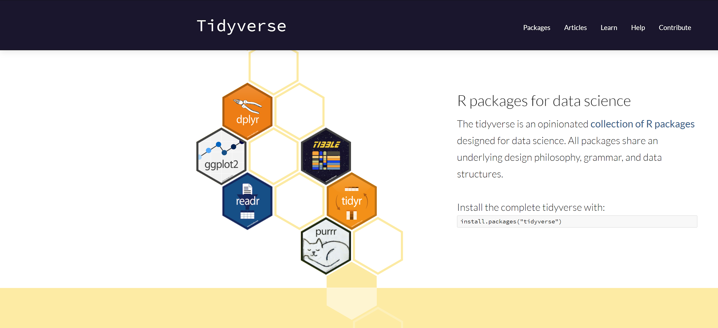
The package two-step
1. Install the package
2. Load it before use
Demonstration: tidyverse

Slide 22


Time to launch RStudio...

Slide 23
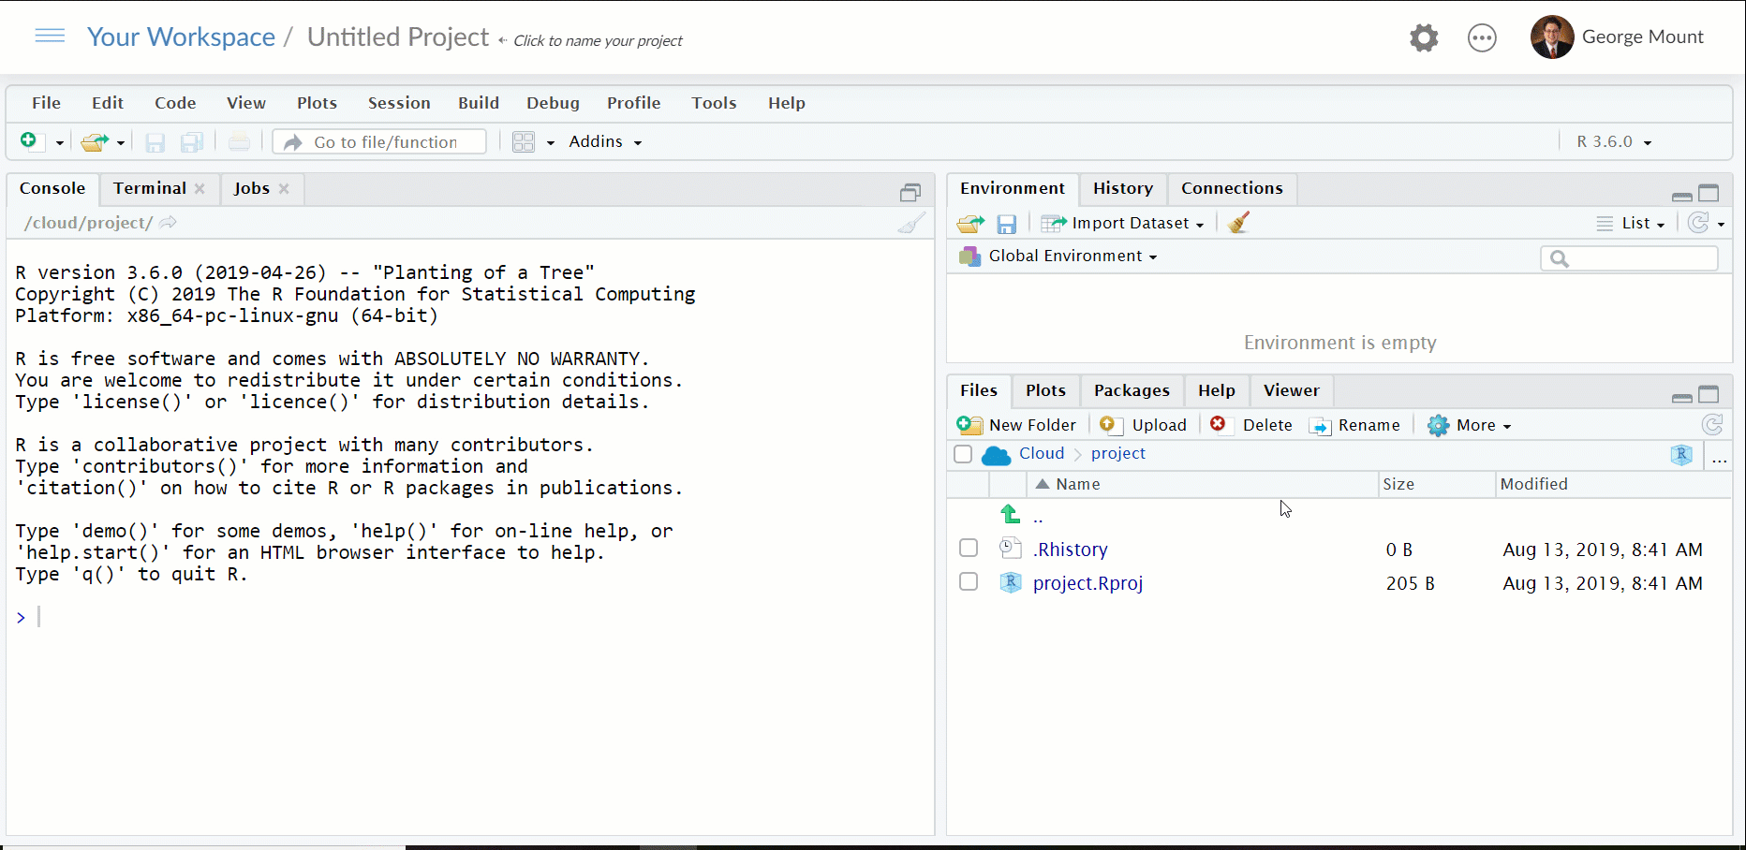
install.packages(“tidyverse”, dependencies = TRUE)

Slide 24
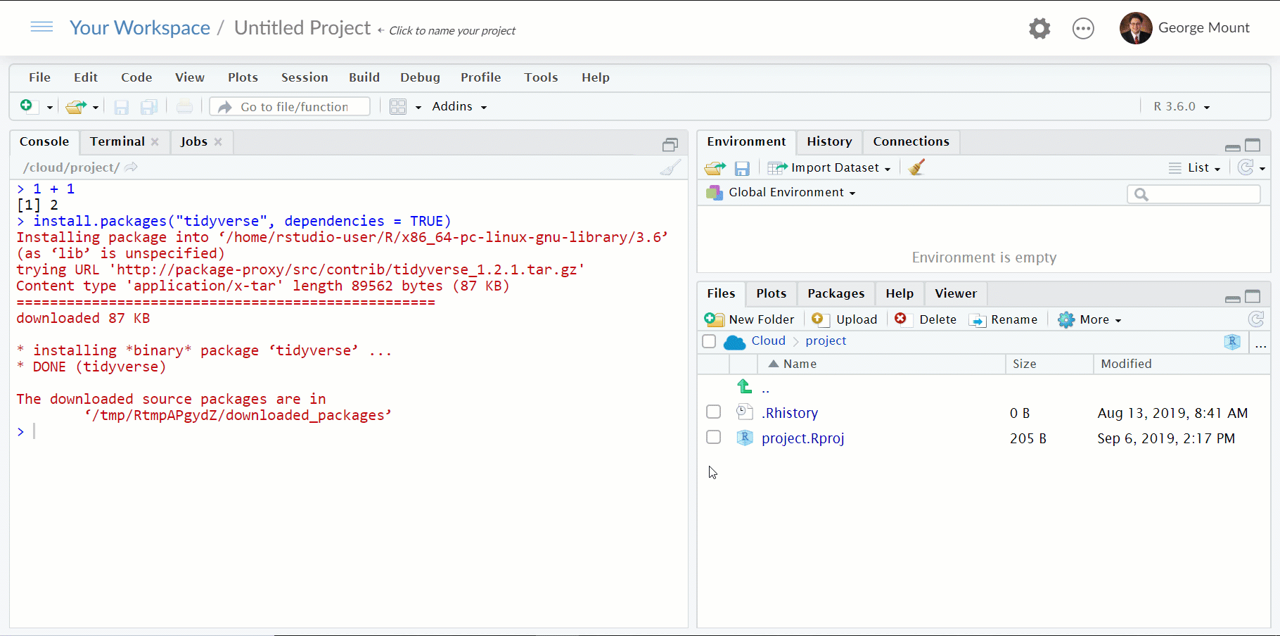
library(tidyverse)

Slide 25

Spinning R playlists: CRAN Taskviews
https://cran.r-project.org/web/views/

Slide 26
Initialize the taskview package:
install.packages(“ctv”)
library(ctv)
Explore and install the Extreme Value taskview:
install.views(“ExtremeValue”)
Drill: Install a taskview
Notes:
I am doing this one because it is a smaller one

Slide 27
Questions?

Slide 28
R-Powered Excel for Business Analytics
Month/Year

Slide 29
From Excel calculations to R development

Slide 30
Demo: calculations-in-excel.xlsx

Slide 31
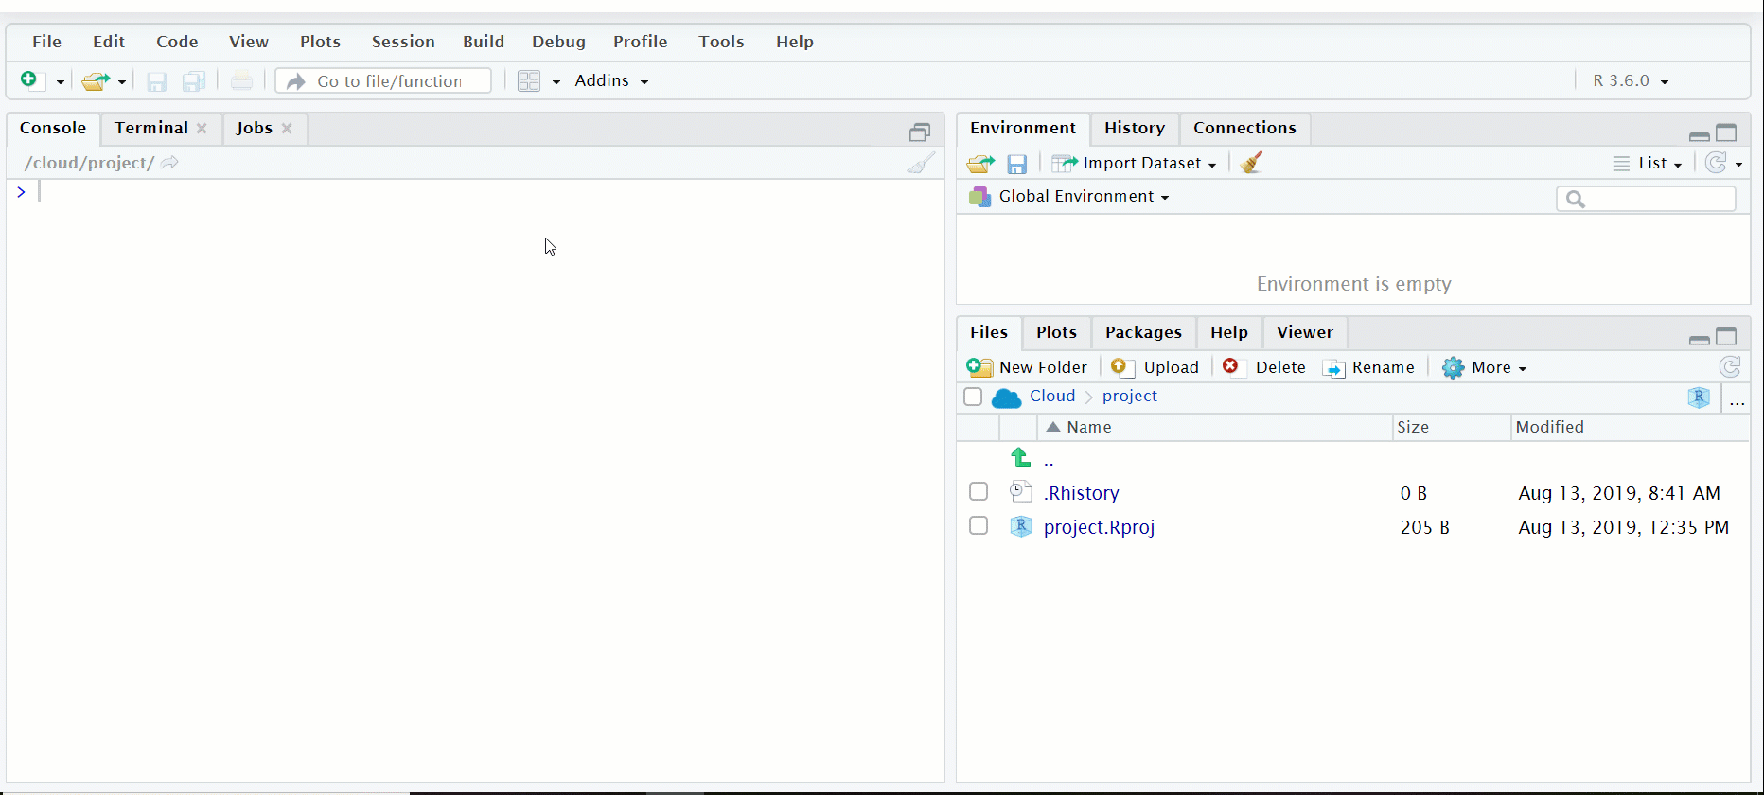
Starting in the console at 1 + 1 ...

Slide 32
Demo: r-development-code.r

Slide 33
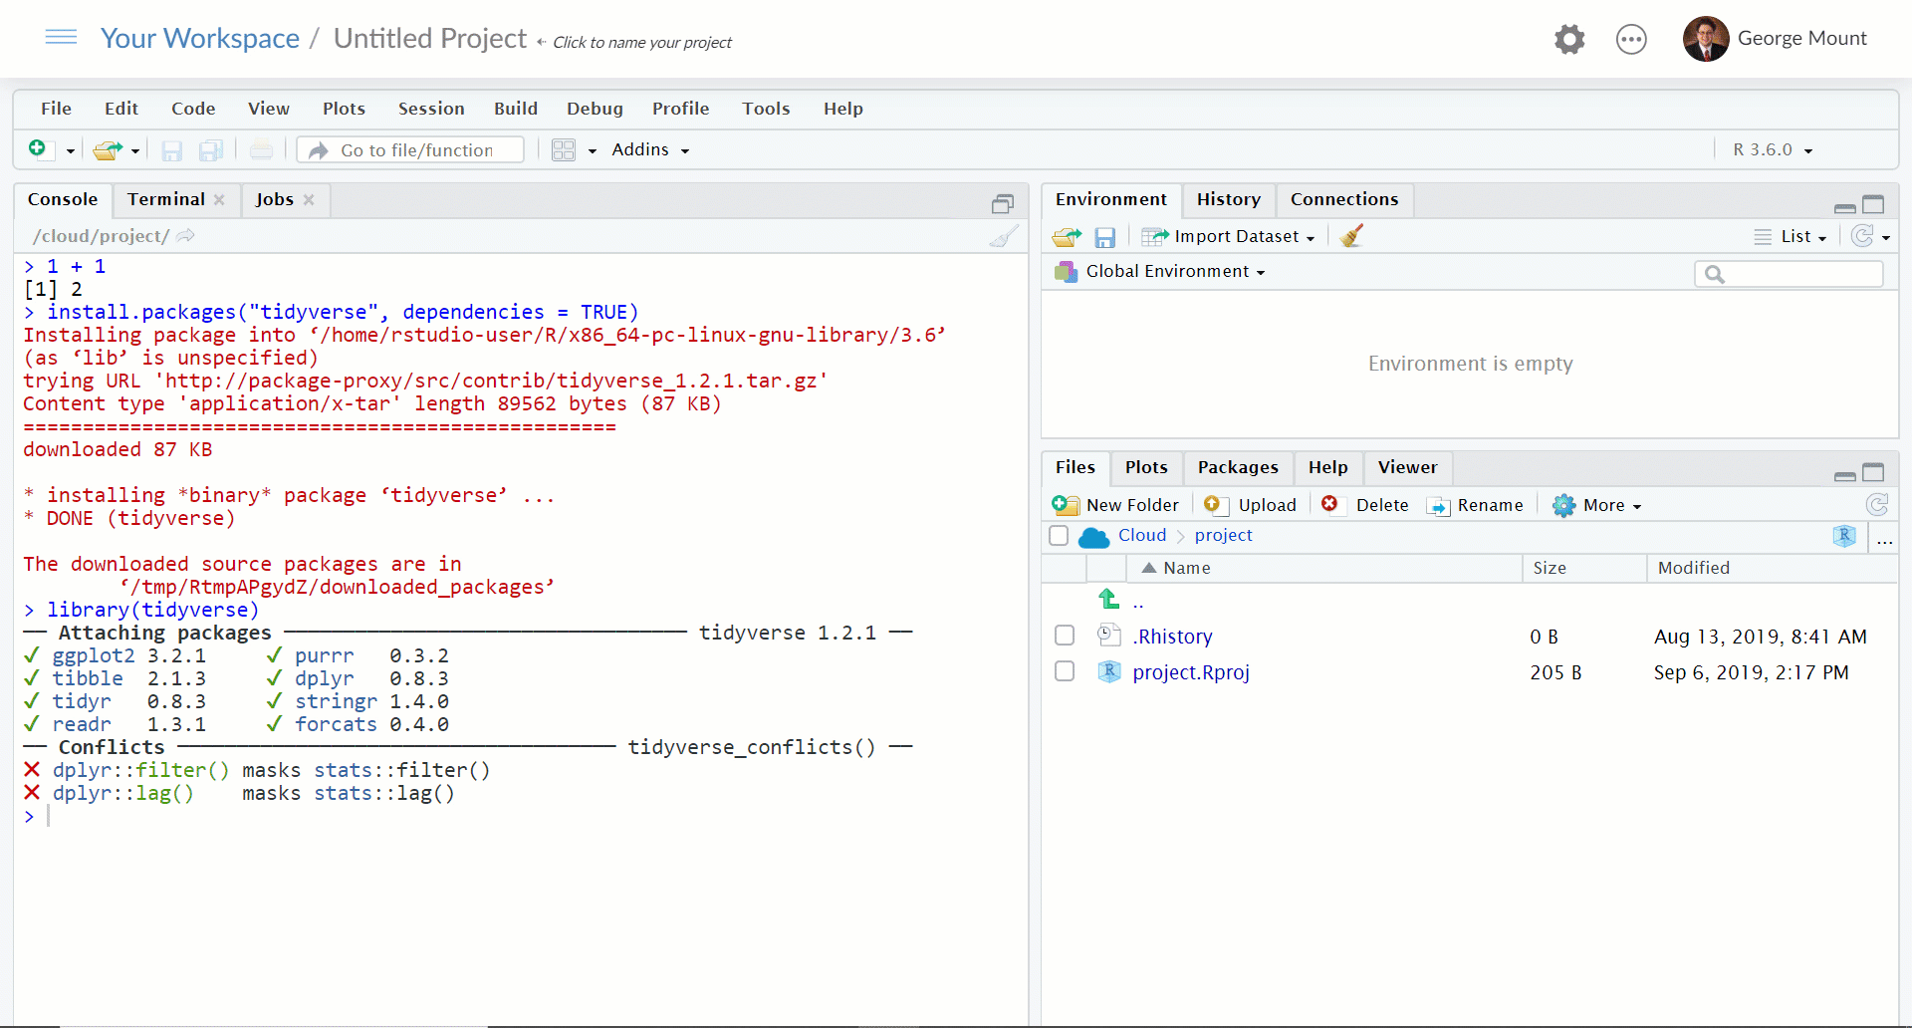
Before drills, a fun part of RStudio: Custom workspaces

Slide 34
Using RStudio (and plenty of comments)...
Assign the sum of 1 to 4 as a
Assign the square root of a as b
Assign b minus 1 as d
Is d greater than 2?
Drill: working with objects
Notes:
Show the Excel demo

Slide 35
Using RStudio (and plenty of comments)...
Assign the sum of 1 to 4 as a
Assign the square root of a as b
Assign b minus 1 as d
Is d greater than 2?
Solutions: r-development-drills.r
Drill: working with objects
Notes:
Show the Excel demo

Slide 36
Questions?

Slide 37
R-Powered Excel for Business Analytics
Month/Year

Slide 38
From Excel cells to R vectors

Slide 39
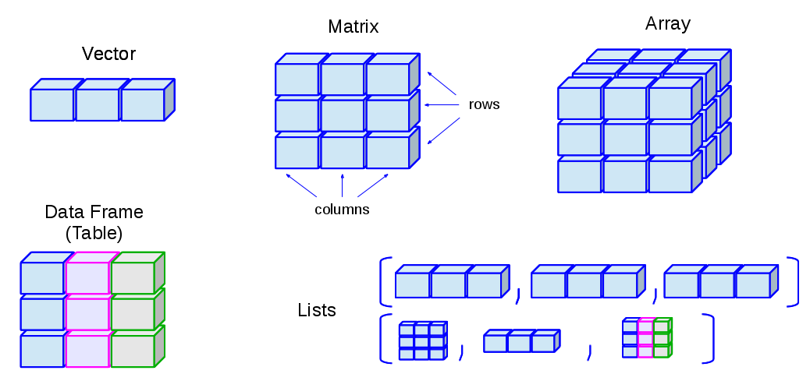
https://blog.usejournal.com/understand-basic-to-advance-data-structure-used-in-r-to-use-efficiently-b51b7fd8aff0

Slide 40
Demo: intro-to-vectors.xlsx

Slide 41
Demo: excel-cells-to-r-vectors.r

Slide 42
Create a vector names containing the names of five coworkers.
Access the 1st and 4th values of this vector.
Create two vectors x and y of length 4; one containing numeric and the other logical values. Multiply them and pass the result to z. What is the result?
Drill: Manipulating vectors in R
Notes:
And I will give you a little more time so you can navigate what is going on here.

Slide 43
Create a vector names containing the names of five coworkers.
Access the 1st and 4th values of this vector.
Create two vectors x and y of length 4; one containing numeric and the other logical values. Multiply them and pass the result to z. What is the result?
Solutions: excel-vectors-drills.r
Drill: Manipulating vectors in R
Notes:
And I will give you a little more time so you can navigate what is going on here.

Slide 44
Questions?

Slide 45
R-Powered Excel
Month/Year

Slide 46
From Excel tables to R data frames

Slide 47
Demo: excel-tables.xlsx

Slide 48
https://blog.usejournal.com/understand-basic-to-advance-data-structure-used-in-r-to-use-efficiently-b51b7fd8aff0

Slide 49
Demo: data-frames-in-r.r

Slide 50
Using the mtcars data frame from base R:
How many rows and columns are there?
Assign the first dozen rows to mtcars_head.
Using the log() function, create a column hp_log which is a log-transformation of the column hp.
Rename the column mpg as miles_per_gallon
Drill: Working with data frames
Notes:
And I will give you a little more time so you can navigate what is going on here.

Slide 51
Using the mtcars data frame from base R:
How many rows and columns are there?
Assign the first dozen rows to mtcars_head.
Using the log() function, create a column hp_log which is a log-transformation of the column hp.
Rename the column mpg as miles_per_gallon
Solutions: data-frames-in-r.drills
Drill: Working with data frames
Notes:
And I will give you a little more time so you can navigate what is going on here.

Slide 52
Intro to interfacing R and Excel

Slide 53
LOTS of R-Excel interfaces...

Slide 54
LOTS of R-Excel interfaces...
gdata
readxl
openxlsx
writexls
XlConnect
xlsx
excel.link
etc...

Slide 55
… many with outside requirements
gdata (perl)
readxl
openxlsx
writexls (perl)
XlConnect (rJava)
xlsx (rJava)
excel.link
etc...

Slide 56

For quick reads into R: readxl

Slide 57
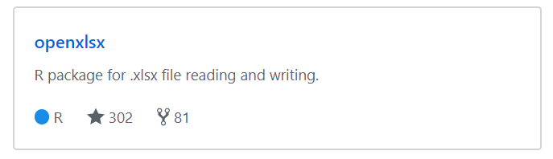
For full-service “R-powered Excel:” openxlsx
https://github.com/awalker89/openxlsx

Slide 58
Demo: demo-reading-writing-to-from-r.r

Slide 59
Using the datasets from nycflights13:
Export airlines, airports and planes as worksheets of the same workbook, formatted as tables.
Read the planes worksheet back into R using openxlsx.
Read the airports worksheet back into R using readxl.
Drill: Interfacing R and Excel
Notes:
And I will give you a little more time so you can navigate what is going on here.

Slide 60
Using the datasets from nycflights13:
Export airlines, airports and planes as worksheets of the same workbook, formatted as tables.
Read the planes worksheet back into R using openxlsx.
Read the airports worksheet back into R using readxl.
Solutions: drills-reading-writing-to-from-r.r
Drill: Interfacing R and Excel
Notes:
And I will give you a little more time so you can navigate what is going on here.

Slide 61




If it’s a dataset, R can probably read it

Slide 62
Questions?

Slide 63
R-Powered Excel
Month/Year

Slide 64
From PivotTables to dplyr manipulation

Slide 65
Demo: pivot-dplyr-demo.xlsx

Slide 66

dplyr: a grammar of data manipulation

Slide 67
Important dplyr “verbs”
Function What it does
mutate() | Creates new columns based on exsiting columns
select() | Selects selected columns
rename() | Renames selected columns
arrange() | Reorders rows
filter() | Selects rows based on condition
group_by() | Groups records by selected columns
summarise() | Aggregates values for each group

Slide 68
Demo: dplyr-manipulation-demo.r

Slide 69
Create a new data frame, iris_log, based on the existing iris data frame. Continue assigning the output to this object.
Create Petal.Length_log and Petal.Width_log which are log-transformation of their respective fields.
Filter this data frame to contain only records from the setosa species.
Sub-set this data frame to keep only the Species, Petal.Length_log and Petal.Width_log fields.
Drills: dplyr manipulation
Notes:
And I will give you a little more time so you can navigate what is going on here.

Slide 70
Create a new data frame, iris_log, based on the existing iris data frame. Continue assigning the output to this object.
Create Petal.Length_log and Petal.Width_log which are log-transformation of their respective fields.
Filter this data frame to contain only records from the setosa species.
Sub-set this data frame to keep only the Species, Petal.Length_log and Petal.Width_log fields.
Solutions: dplyr-manipulation-drills.r
Drills: dplyr manipulation
Notes:
And I will give you a little more time so you can navigate what is going on here.

Slide 71
dplyr: the power of the pipe

Slide 72
Important dplyr “verbs”
Function What it does
mutate() | Creates new columns based on exsiting columns
select() | Selects selected columns
rename() | Renames selected columns
arrange() | Reorders rows
filter() | Selects rows based on condition
group_by() | Groups records by selected columns
summarise() | Aggregates values for each group
%>% | Connect multiple verbs into a “pipeline”

Slide 73
Demo: dplyr-pipe-demo.r

Slide 74
Using the teams data frame from Lahman:
Get average annual attendance for all NL teams, sorted from high to low.
Drills: dplyr pipeline
Notes:
And I will give you a little more time so you can navigate what is going on here.

Slide 75
Using the teams data frame from Lahman:
Get average annual attendance for all NL teams, sorted from high to low.
Solutions: dplyr-pipe-drills.r
Drills: dplyr pipeline
Notes:
And I will give you a little more time so you can navigate what is going on here.

Slide 76
From VLOOKUP() to dplyr join()

Slide 77
Demo: lookup-join-demo.xlsx

Slide 78
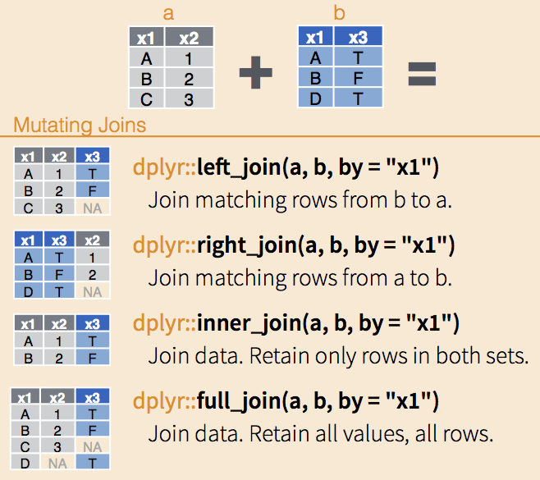
From VLOOKUP() duct tape to join() welder
http://data-lessons.github.io/gapminder-R/fig/dplyr-joins.png

Slide 79
Demo: join-demo.r

Slide 80
Using the Managers and AwardsManagers data frames from Lahman (ignore the warnings):
Return the join of records found in both tables. Keep all fields.
Return the join of records found in both tables. Keep all fields except Managers$rank.
Return the join of records for all found in Managers.
How many more rows does this have than the results of 1?
Drills: Joining data frames
Notes:
And I will give you a little more time so you can navigate what is going on here.

Slide 81
Using the Managers and AwardsManagers data frames from Lahman (ignore the warnings):
Return the join of records found in both tables. Keep all fields.
Return the join of records found in both tables. Keep all fields except Managers$rank.
Return the join of records for all found in Managers.
How many more rows does this have than the results of 1?
Solutions: join-drills.r
Drills: Joining data frames
Notes:
And I will give you a little more time so you can navigate what is going on here.

Slide 82
Questions?

Slide 83
R-Powered Excel
Month/Year

Slide 84
From that’s hard in Excel to that’s easy in R!

Slide 85
Demo: sales-report.xlsx

Slide 86
Demo: sales-report-prep.r

Slide 87
Find the average sales for each category, sorted A-Z
Find the total sales for each region, sorted from high to low
Return all transactions for regions 1 and 2, sorted by id, leaving region out of the report
Drill: Sales report analysis (hint: think pipe!)
Notes:
And I will give you a little more time so you can navigate what is going on here.

Slide 88
Find the average sales for each category, sorted A-Z
Find the total sales for each region, sorted from high to low
Return all transactions for regions 1 and 2, sorted by id, leaving region out of the report
Solutions: sales-report-analysis.r
Drill: Sales report analysis (hint: think pipe!)
Notes:
And I will give you a little more time so you can navigate what is going on here.

Slide 89

Welcome to reproducibility

Slide 90
Questions?

Slide 91
R-Powered Excel
Month/Year

Slide 92
From Excel domination to R domination
Five ways to get help in R

Slide 93
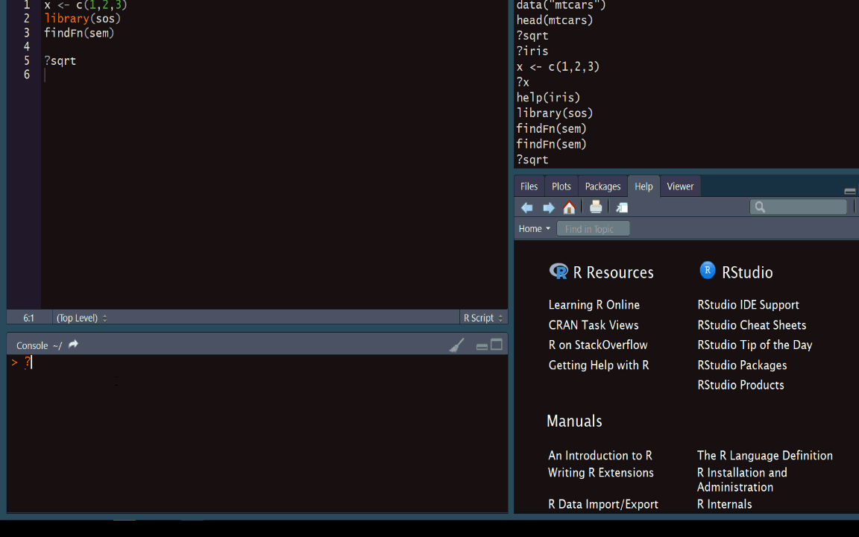
Search for exact term with ?

Slide 94
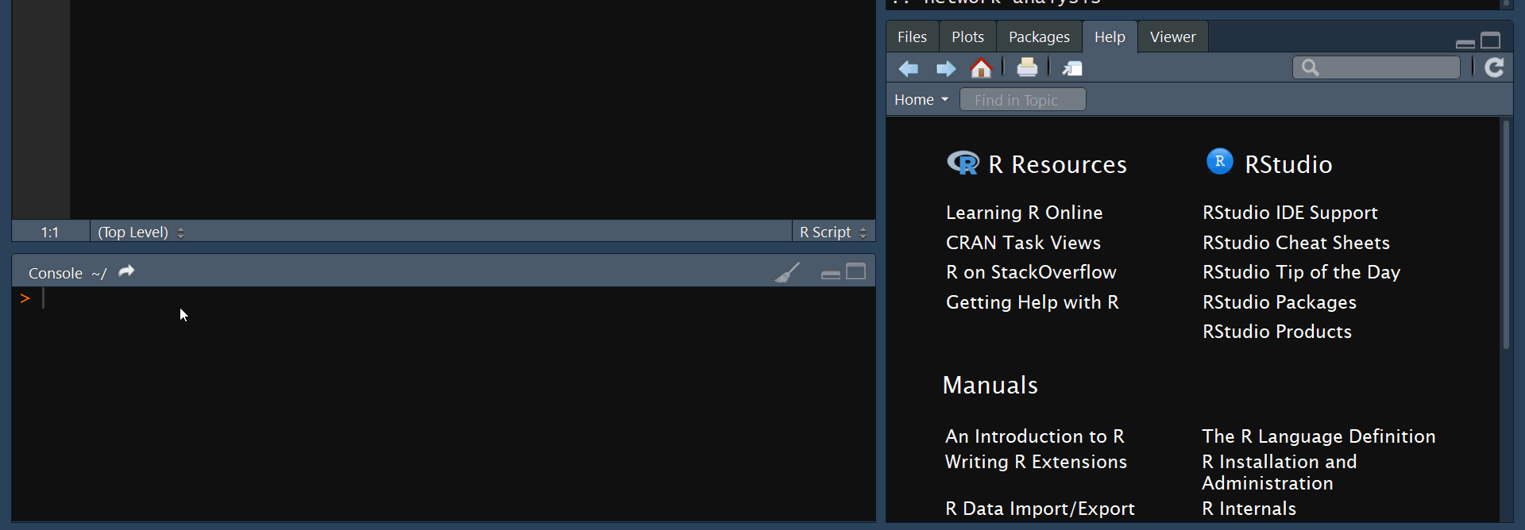
Search for approximate term with ??

Slide 95
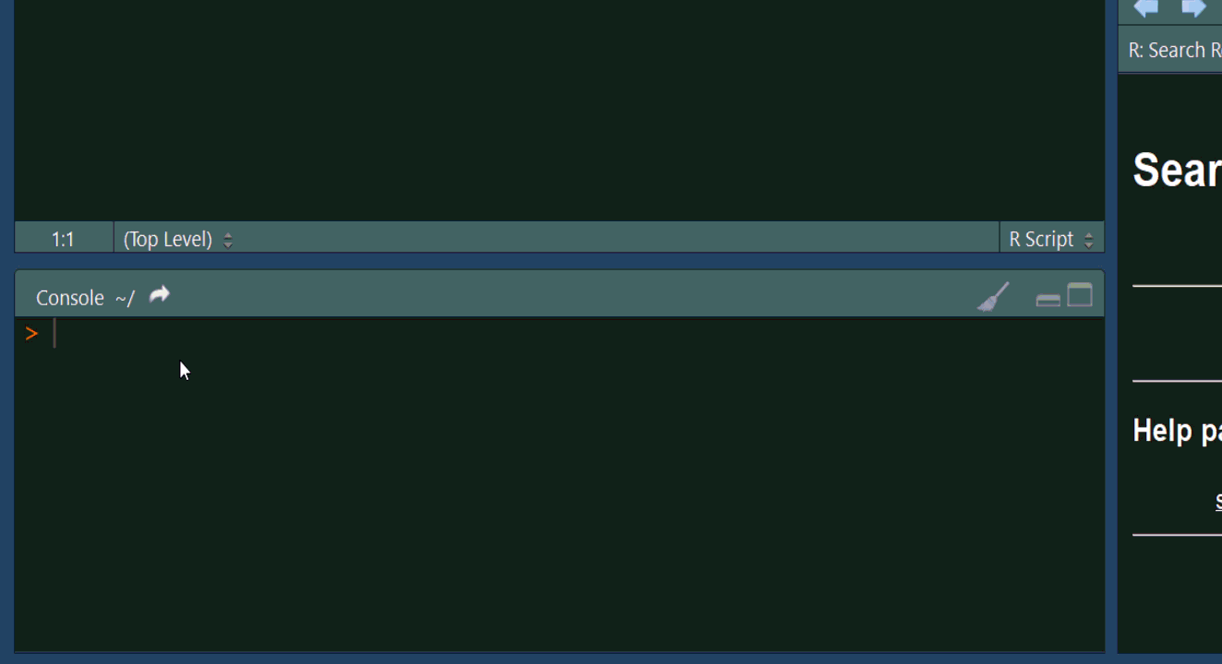
Search search.r-project.org with RSiteSearch()

Slide 96
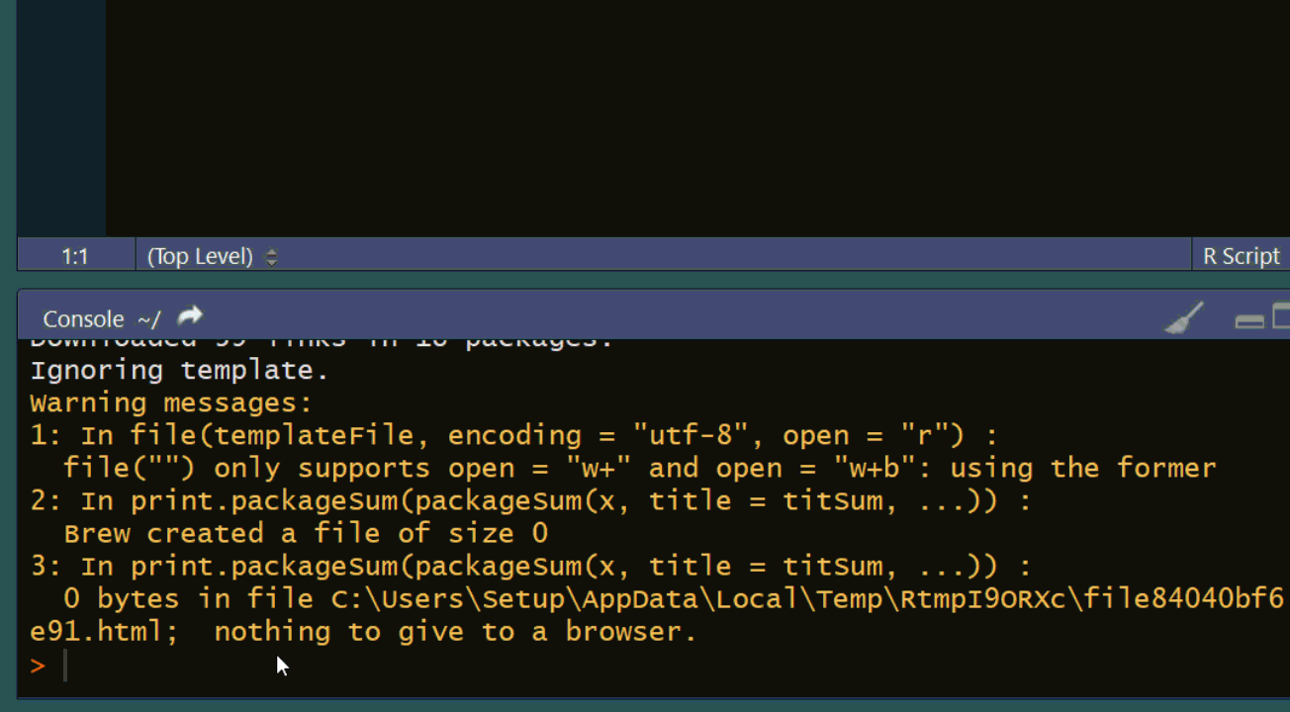
Search search.r-project.org for functions with findFn()
Notes:
Requires sos package

Slide 97
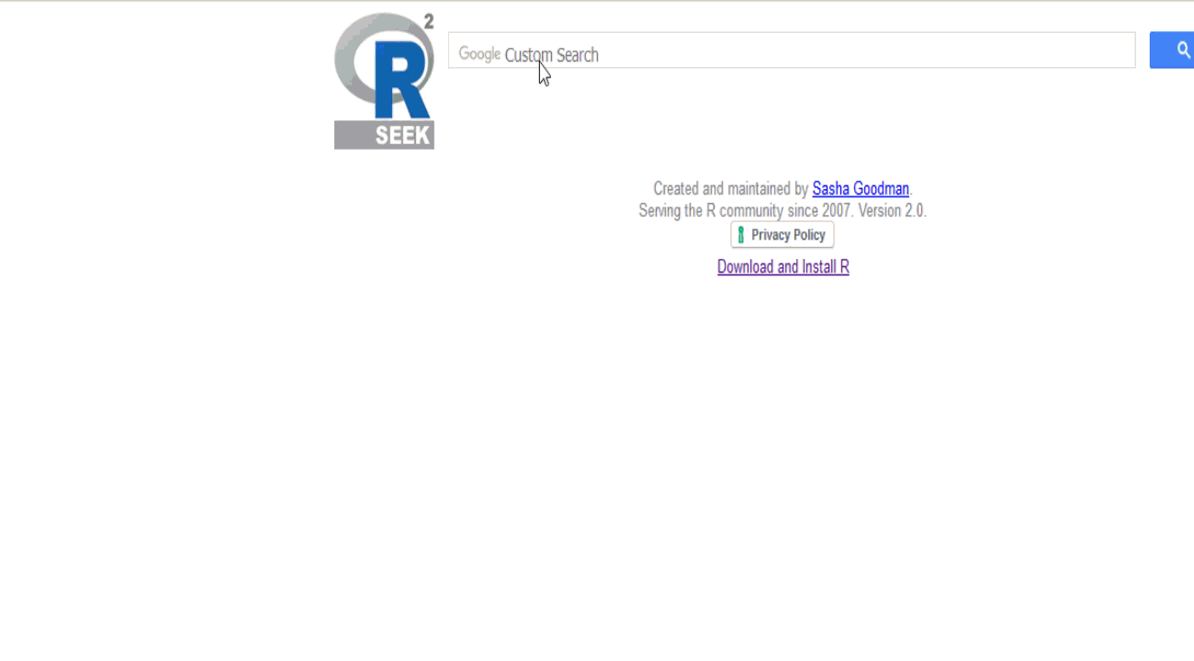
Use rseek.org as a search engine for R
Notes:
Requires sos package

Slide 98
From Excel domination to R domination
Recommended resources

Slide 99
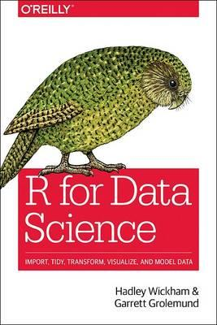
R for Data Science
by Hadley Wickham & Garrett Grolemund
On O’Reilly Learning at https://learning.oreilly.com/library/view/r-for-data/9781491910382/

Slide 100

R Cookbook, 2nd Edition
by Anthony Molinaro
On O’Reilly Learning at https://learning.oreilly.com/library/view/r-cookbook-2nd/9781492040675/

Slide 101
Find me
georgejmount.com
@gjmount
github.com/summerofgeorge

Slide 102
Thank you

